Slide 1
Purchase Pattern Analytics
Gender, Age, Category & Payment Insights
Prepared by: Akshay Rathod and Vinayak Chaudhari
Project ID:PTID-CDA-DEC-25-970
Tool Used: SQL , Python

Slide 2
PROJECT OVERVIEW
Objective of the Project
➤ To analyze customer purchase patterns in retail transactions ➤ To identify frequently purchased product combinations ➤ To perform Market Basket Analysis using the apriori algorithm ➤ To understand relationships between products purchased together ➤ To generate data-driven recommendations for cross-selling and product bundling
Dataset Overview
➤ Time Period: December 2010 – December 2011 ➤ Data Source: Online Retail Transaction Dataset ➤ Dataset includes:
➤ Transaction ID (BillNo) ➤ Product name (Itemname) ➤ Quantity of products purchased ➤ Purchase date and time ( Present_Date ) ➤ Product price ➤ Customer ID ➤ Customer country
Tools Used
Power BI – Data Modeling & Dashboarding
DAX – KPI & Measure calculations

Slide 3
Tools Used
➤ SQL (MySQL) – Data extraction and cleaning ➤ Python (Pandas, Matplotlib, Seaborn) – Data analysis and visualization ➤ MLxtend Library – Apriori algorithm implementation ➤ Jupyter Notebook – Analysis and experimentation ➤ PowerPoint – Presentation of insights
Expected Outcome
➤ Identify frequent itemsets purchased together ➤ Discover association rules between products ➤ Provide business recommendations for product bundling ➤ Improve sales strategies and customer experience

Slide 4
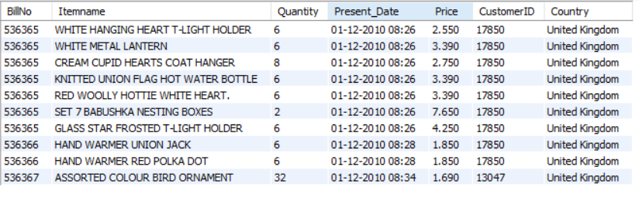


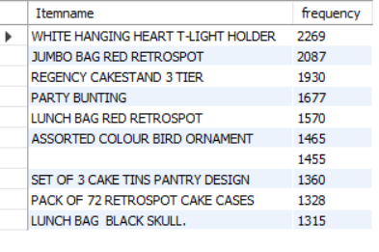
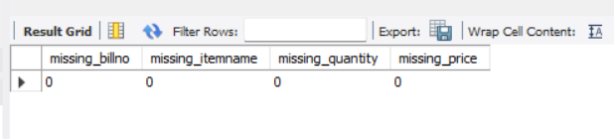
View the Dataset
Total Transaction
Total Rows
Frequency of Iteam
No Missing Value Are Present In Data Set

Slide 5
Apriori Insight :-
134 frequent item sets found
1936 association rules generated
Lift = 9.25 — very strong product associations!
Confidence = 1.0 — 100% certainty on top rules

Slide 6
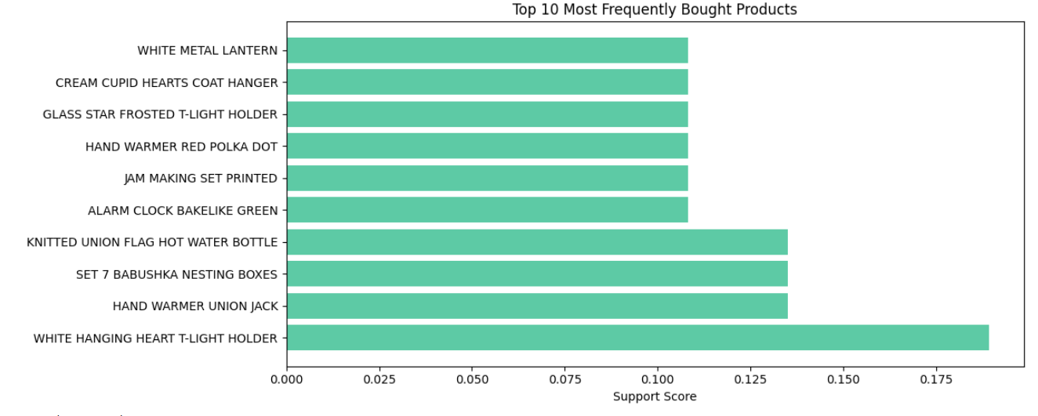
Top products bar chart
Product Category Insights
Clothing is the highest revenue-generating category
Shoes and Technology are strong secondary contributors
Categories such as Books and Souvenirs contribute relatively less revenue
Category preference varies across different age groups and genders
Payment Method Insights
Cash is the most preferred payment method overall
Credit card usage is high among middle-aged customers
Payment preferences vary by age group and gender, indicating a clear relationship
WHITE HANGING HEART T-LIGHT HOLDER is the #1 most bought product (support ~0.19)

Slide 7
BUSINESS RECOMMENDATIONS :-
 | Recommendation | Based On
1 | Bundle top associated products | Lift = 9.25, Confidence = 1.0
2 | Optimize store layout | Co-purchase patterns
3 | Cross-sell online | Top association rules
4 | Target UK marketing | 90.77% revenue from UK
5 | Stock management | Top demand products
6 | Expand international | France/Australia only 9.23%

Slide 8
CONCLUSION
This project successfully implemented a complete end-to-end data analytics pipeline on a retail transaction dataset using SQL, Python, the Apriori algorithm, and Power BI. Over four weeks, the team performed exploratory data analysis, data cleaning, market basket analysis, and interactive dashboard development to extract meaningful business insights from 400 transactions across 26 customers.
➤ United Kingdom dominates sales with 90.77% of total revenue ($13.83K out of $15.24K total), followed by France, Australia, and Netherlands.
➤ CHILLI LIGHTS, LIGHT GARLAND BUTTERFILES PINK, and WOODEN OWLS LIGHT GARLAND were the top 3 revenue-generating products.
Dashboard:
An interactive Power BI dashboard was developed visualizing total revenue ($15.24K), transactions (37), customers (26), and unique items (286) with dynamic country filtering for stakeholder decision making.
Business Impact:
The insights provide actionable recommendations for product bundling, store layout, cross-selling, and targeted marketing — helping the business increase average order value and maximize revenue.

Slide 9
